Slide 1
Cyberinfrastructure for Water Data: Perspectives from iUTAH’s Data-Intensive Water Research
Jeffery S. Horsburgh
Amber Jones
And the iUTAH Cyberinfrastructure Team

Slide 2


EPSCoR
Experimental Program to Stimulate Competitive Research
innovative
Urban Transitions and Aridregion Hydrosustainability
Build statewide research capacity
Enhance economic competitiveness and sustainability
Strengthen STEM workforce
Notes:
iUTAH is an EPSCoR project, which is funded by NSF. These are not typical research projects- they are focused on building research capacity and infrastructure.
EPSCoR’s goals and roles in Utah.
Utah’s water resources are critical to the state’s industries and economy- hence a project focused on water sustainability.
Idaho and Wyoming are also EPSCoR states- you may be familiar with projects in those states.
Utah graduated from EPSCoR eligibility, meaning that iUTAH as we know it will not be directly renewed from NSF, so we have been working on sustainability of the research and infrastructure that we have developed.

Slide 3
Core Questions
How do water quantity and quality change along the gradient from high elevation snowmelt through Utah’s mountain, urban, and agricultural water systems?
A LOT OF
Answering this question requires data.
⌃

Slide 4
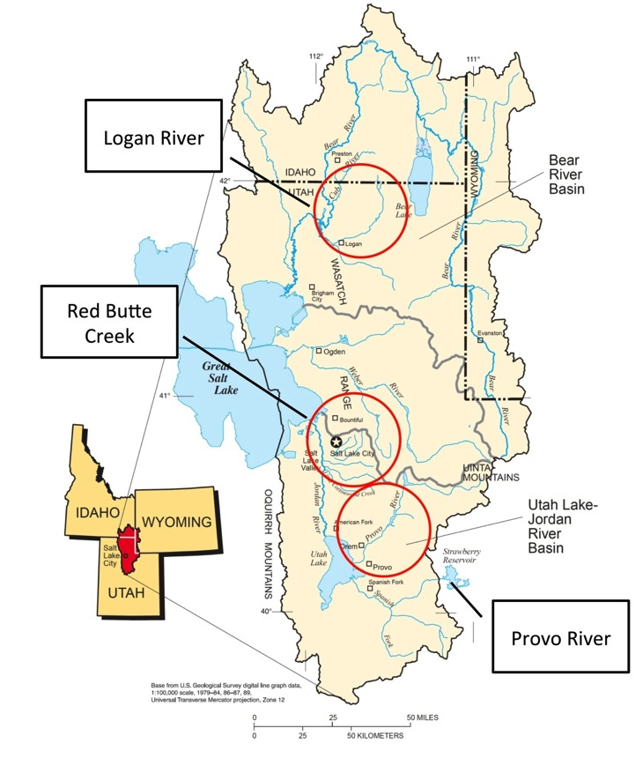
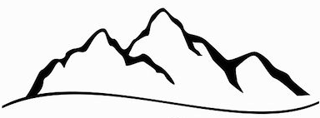
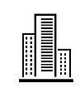

GAMUT: Gradients Along Mountain to Urban Transitions
Three watersheds instrumented from a mountain to urban gradient
Watersheds with similar water source (high elevation snow) but different land use transitions
Mountain to Valley Transition
Fundamental Aquatic Sites
Enhanced Aquatic Sites
Climate/Terrestrial Sites
Notes:
GAMUT started with an idea. Standardize in situ data collection at aquatic and terrestrial climate sites in three different watersheds.
Three different watersheds that represent differing types and patterns of urbanization.
The streams originate with mountain snowpack, flow through canyons, and exit to populated valleys. In all cases, we have mountain water being used by urban people.

Slide 5
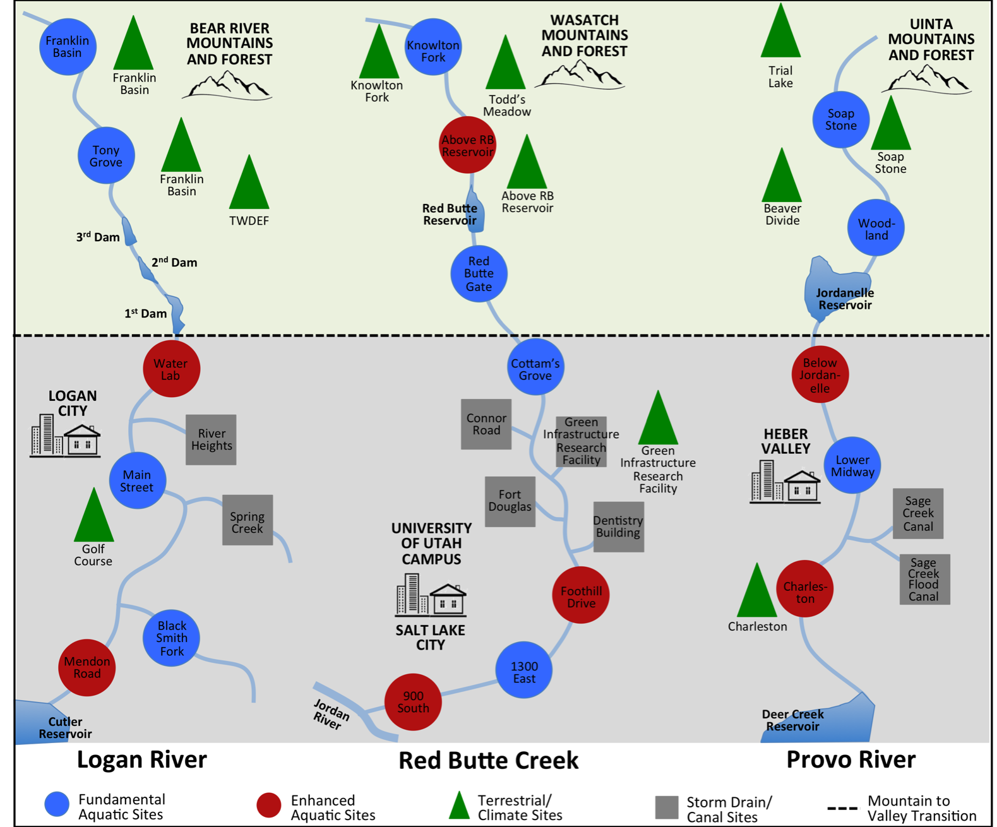

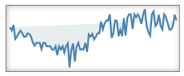
GAMUT: Gradients Along Mountain to Urban Transitions
40 sites
2000 data series
174 million+ values over 3.5 years
Notes:
Each watershed includes several aquatic, climate and storm drain sites.

Slide 6
Challenges
Aggregation of data to a single location
Working across institutions
Storage and management (volume)
Publication and use
It’s more than one person can do
It’s more than one can do with “normal” skills, tools, and software
Commercial software = $$$$$$$

Slide 7
Core Questions
What is an effective design for the cyberinfrastructure that enables:
standardized data collection and management
for a network of aquatic and terrestrial monitoring sites
managed by a consortium of disparate organizations?

Slide 8

Formalized GAMUT Data Workflow
CUAHSI
HIS
Sharing hydrologic data
Building on the CUAHSI Hydrologic Information System
Jones, A.S., J. S. Horsburgh, S.L. Reeder, M. Ramirez, J. Caraballo (2015). A data management and publication workflow for a large-scale, heterogeneous sensor network, Environmental Monitoring and Assessment, 187:348, http://dx.doi.org/10.1007/s10661-015-4594-3.

Slide 9
Sensor Data Acquisition
Notes:
Regularly acquire data from remote field sites to a centralized base station.

Slide 10
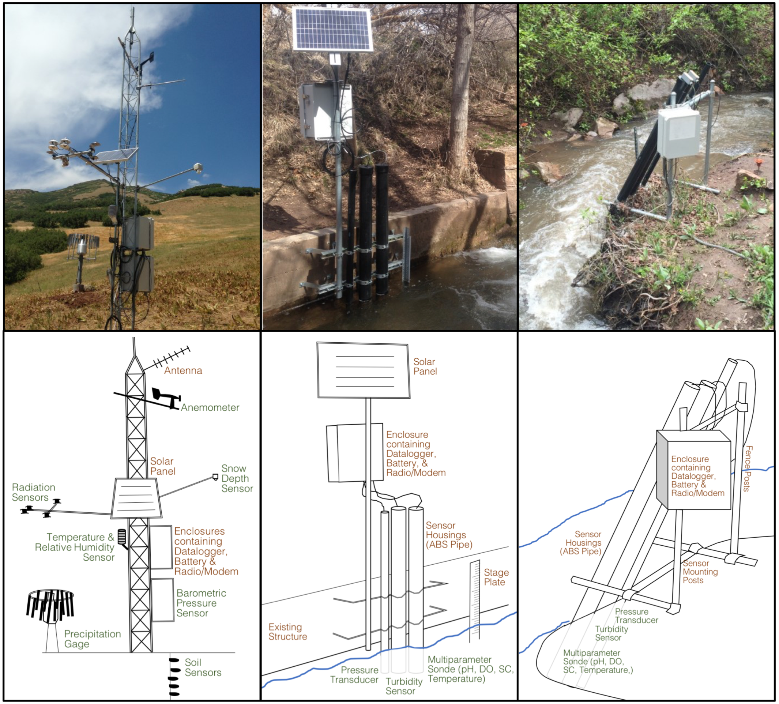
GAMUT: Gradients Along Mountain to Urban Transitions
Standardized site design and programming
Standardized sensor suite
Observed variables:
Streamflow
Temperature
pH
Specific Conductance
Dissolved Oxygen
Turbidity
fDOM
Chlorophyll
Phycocyanin
Nitrate
Hired a field technician for each watershed
Notes:
Basic vs. Enhanced wq sites

Slide 11
Sensor Data Aggregation
Notes:
Regularly acquire data from remote field sites to a centralized base station.

Slide 12
Sensor Data Aggregation
Transfer of data from field sites to a central location
Management of telemetry connections
Monitoring of communication status
Unique challenges
Different systems for different equipment manufacturers
Multiple types of telemetry (radio, cellular)
Low-level hardware access
Our approach:
Use manufacturers’ software to manage communications
Use CSV format as a common denominator
Radio
Telemetry
Radio/Ethernet
Telemetry
CSV
Files
CSV
Files
CSV
Files
Cellular
Telemetry
Loggernet Server

Slide 13
Data Loading and Storage
Notes:
Data within the text files loaded into operational databases using the Streaming Data Loader.

Slide 14
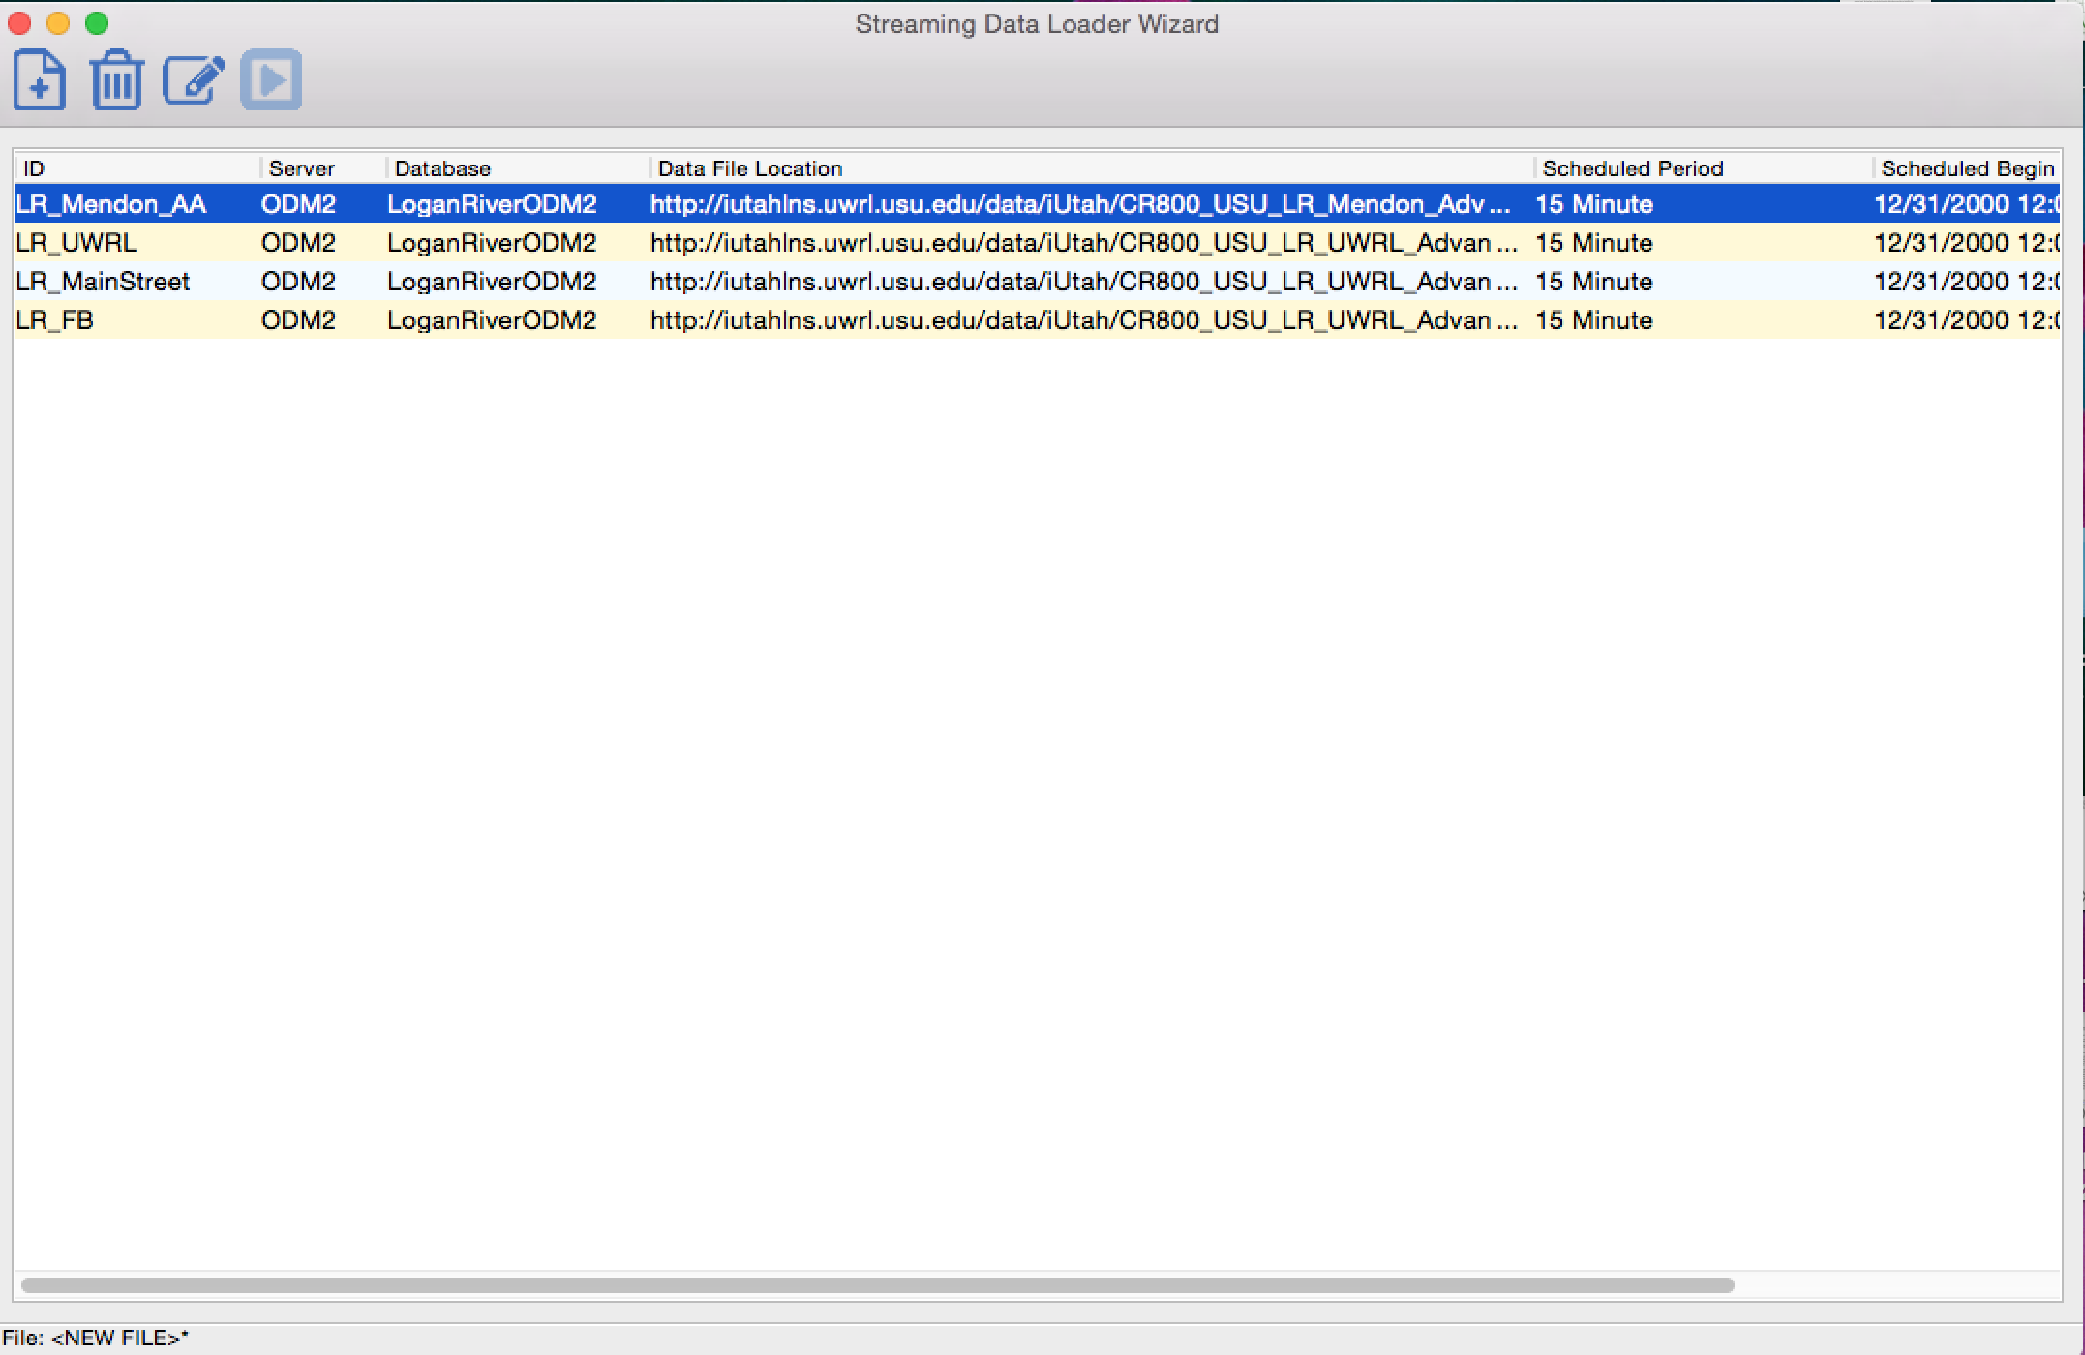

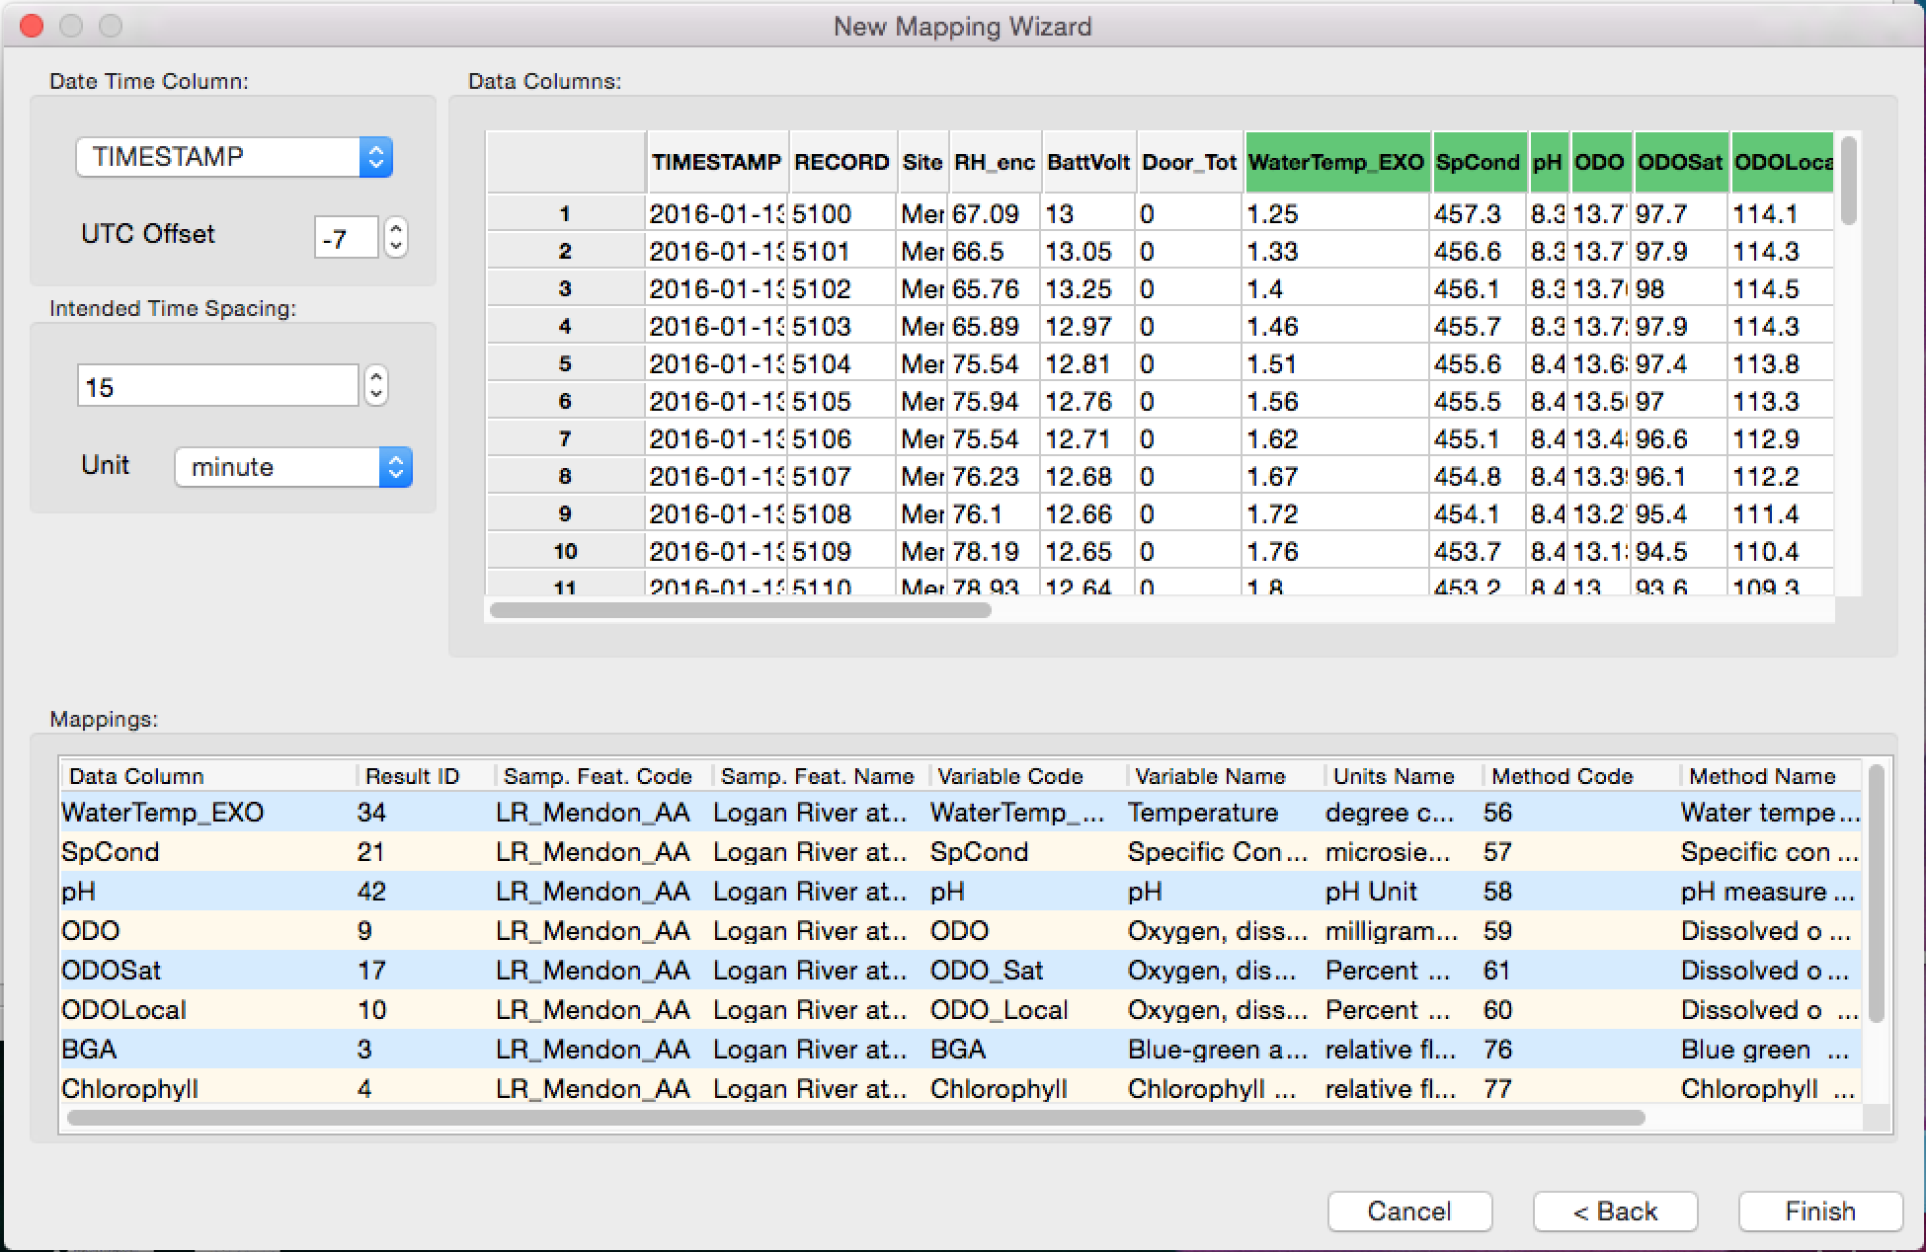
Data Loading and Storage
Notes:
Streaming Data Loader: is a Python-based software application that we have developed to map text-based files from a sensor or datalogger for insertion into an ODM2 database- mapping means that the appropriate metadata is assigned- site, variable, etc..
Once the files are mapped, it is configured to run on a regular schedule so that data loading is automated. It can also be run manually if files are not acquired automatically (i.e., sneaker net)
Features and options include:
Cross-platform and compatible with different database types
Can do bulk or incremental loads

Slide 15
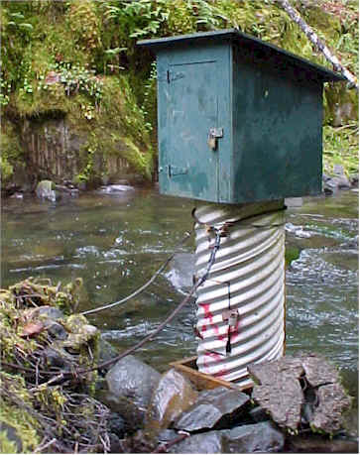
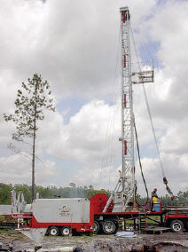
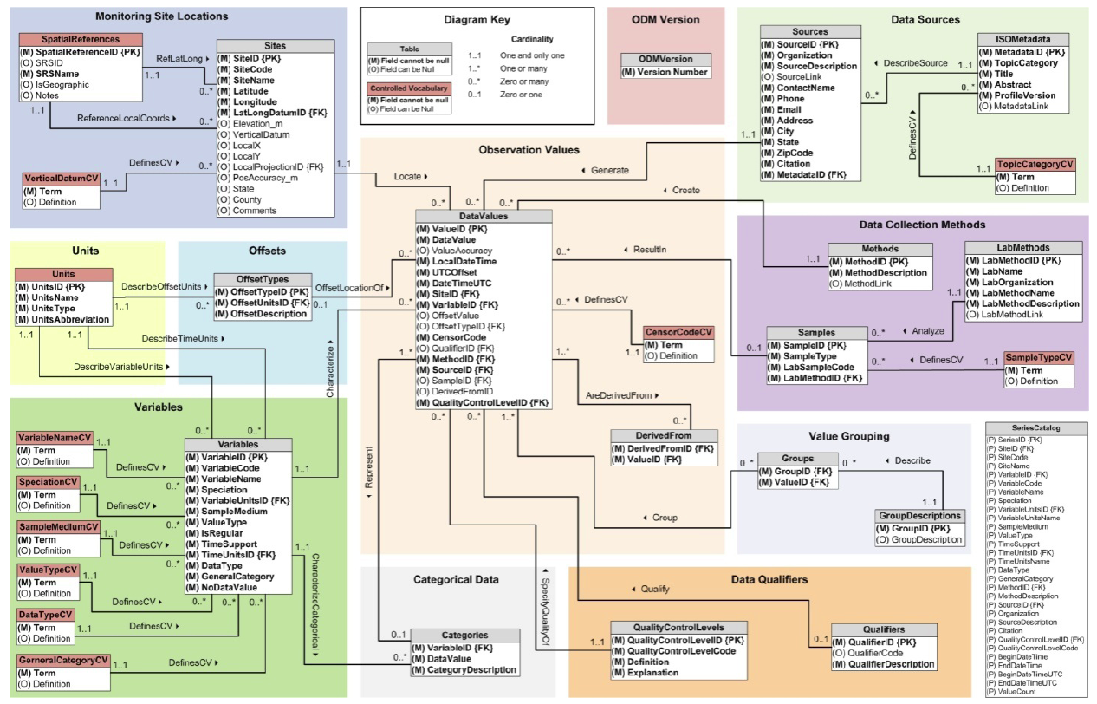
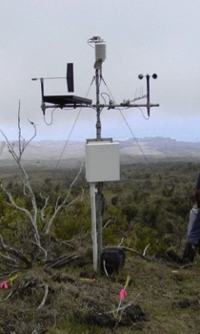
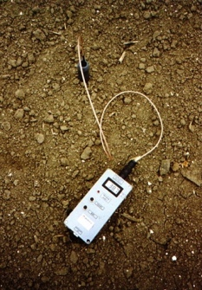
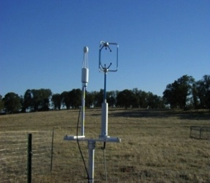
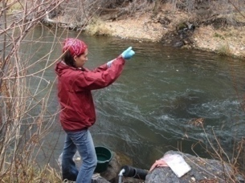
Observations Data Model
Streamflow
Groundwater
levels
Precipitation
& Climate
Soil moisture
Flux tower data
Water Quality
A relational database at the single observation level
Metadata for unambiguous interpretation
Traceable heritage from raw measurements to usable information
Promote syntactic and semantic consistency
Cross dimension retrieval and analysis
Horsburgh, J. S., D. G. Tarboton, D. R. Maidment, and I. Zaslavsky (2008), A relational model for environmental and water resources data, Water Resources Research, 44, W05406, doi:10.1029/2007WR006392.
Notes:
Streaming Data Loader: is a Python-based software application that we have developed to map text-based files from a sensor or datalogger for insertion into an ODM2 database- mapping means that the appropriate metadata is assigned- site, variable, etc..
Once the files are mapped, it is configured to run on a regular schedule so that data loading is automated. It can also be run manually if files are not acquired automatically (i.e., sneaker net)
Features and options include:
Cross-platform and compatible with different database types
Can do bulk or incremental loads

Slide 16
Sensor Data QAQC
Notes:
QA: commonly defined as any practices occurring prior to its collection. e.g., field protocols, calibration schedules and procedures, etc.
off of this workflow
QC: any practices implemented after the data are collected to achieve high data quality.
We have developed and deployed a Python-based software application for quality control post processing

Slide 17
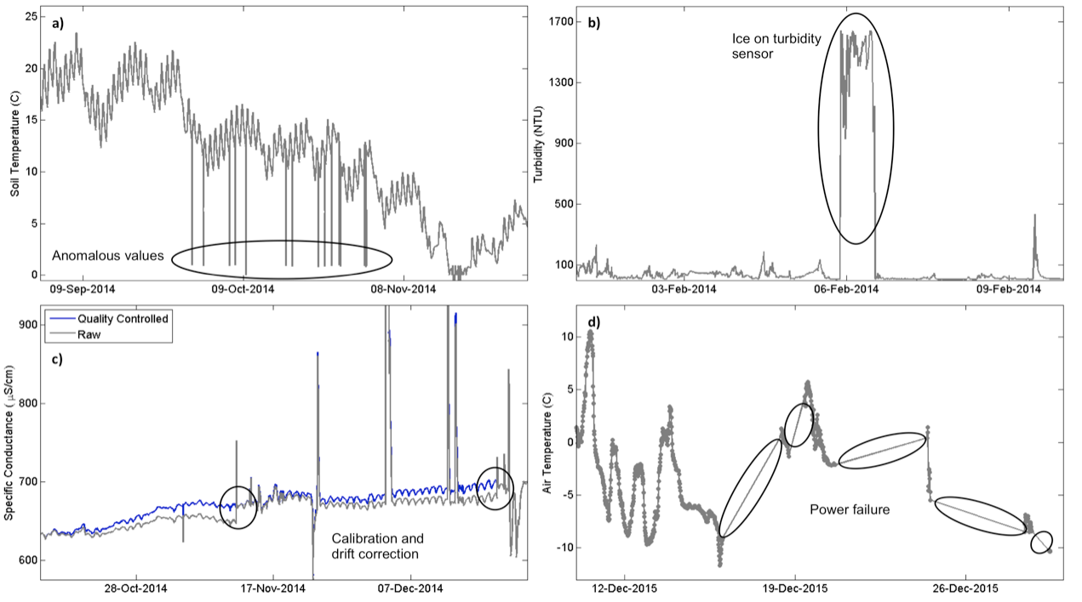
Quality Control of Sensor Data
Continuous, high frequency data require post processing
Modifications to correct for common data errors
Sensor Drift
Fouling
Power failure
Icing
Anomalies
Notes:
GAMUT Technicians perform data post processing to generate approved, quality controlled datasets that remove erroneous outliers, correct for sensor drift, remove periods of sensor malfunction, etc. This image shows typical quality control scenario.
This is no small effort- ongoing effort.
Quality controlled data may be accessed similarly to raw GAMUT data as I just described.

Slide 18
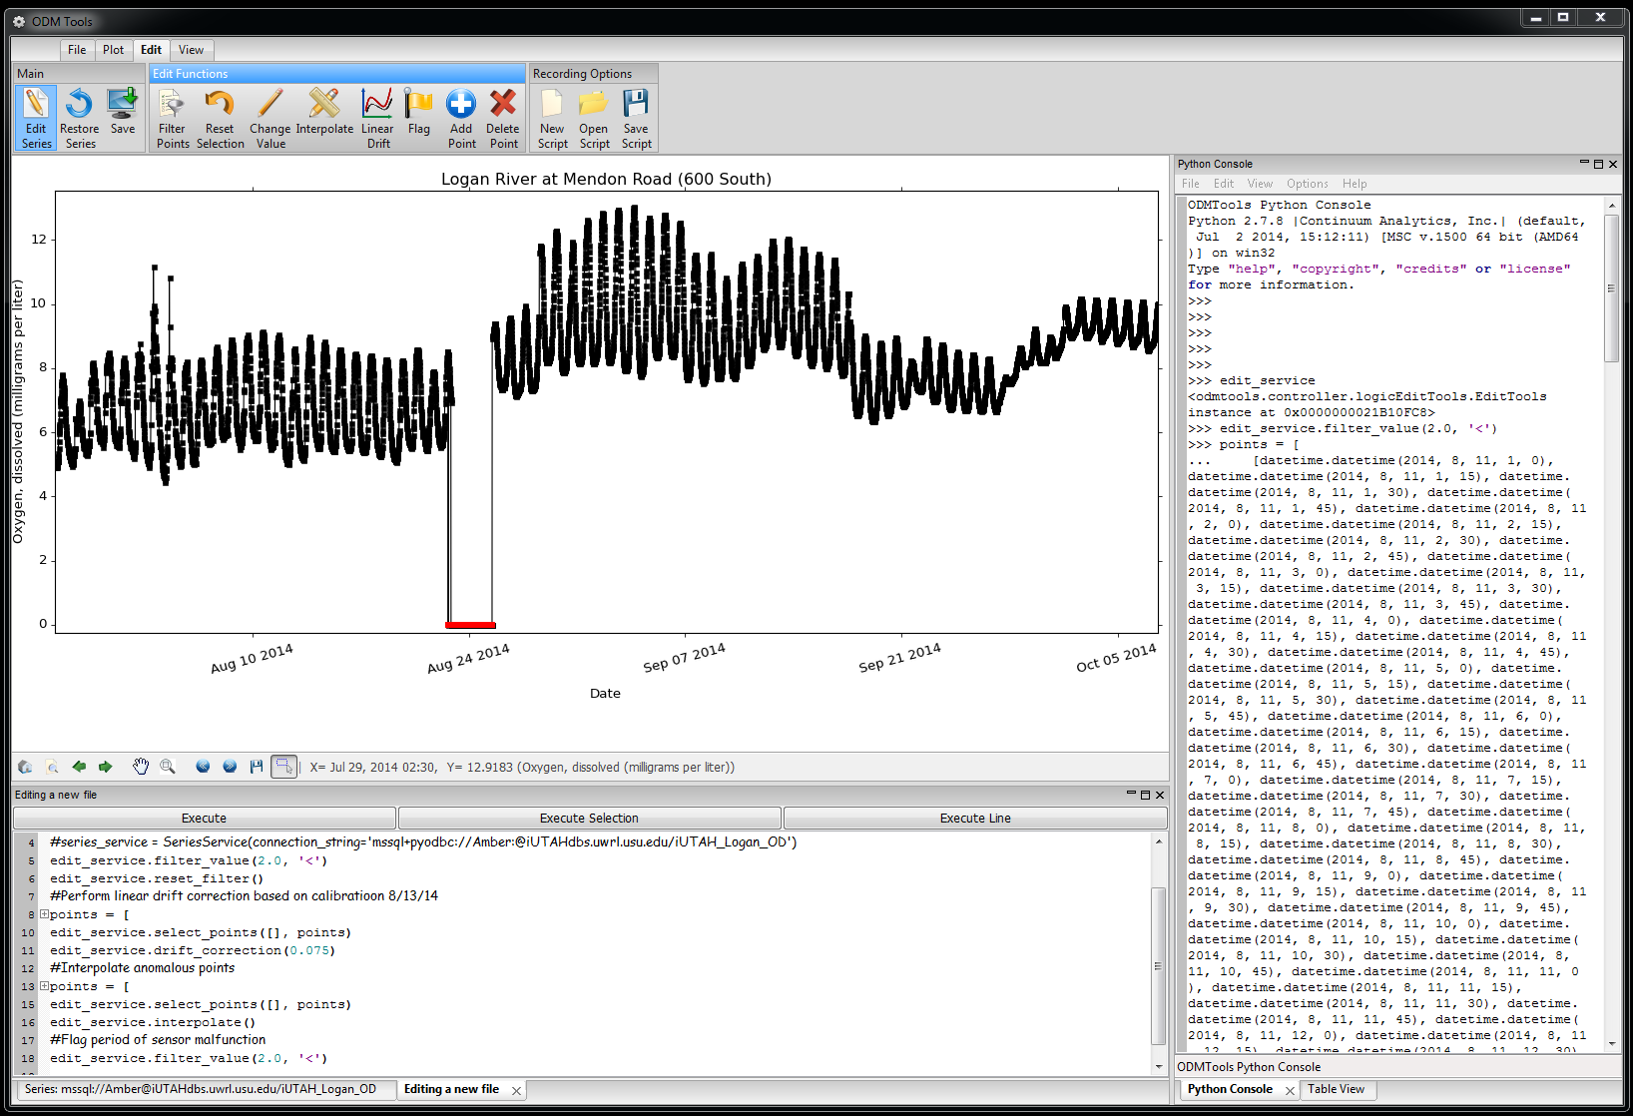
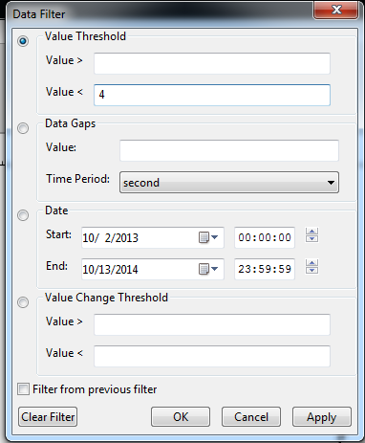
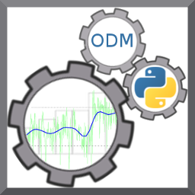
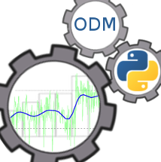
QAQC: Post Processing
Filters on Data Points
Common Editing Tools
Python Code Console
Commit Edits to the Database
Dynamic Data Editing Display
Python Script Editor
Notes:
It’s real focus is in the editing of data series.
Features a python code console and python script editor which records all data edits.
The script serves as a record for all of the processing edits made on the data. This script can be reviewed, making the process from raw data to quality controlled data traceable and also reproducible

Slide 19
Web-Based Data Access
Notes:
resources for data dissemination and visualization.
We have various mechanisms for data dissemination
In particular, we developed a web-based time-series visualization tool

Slide 20
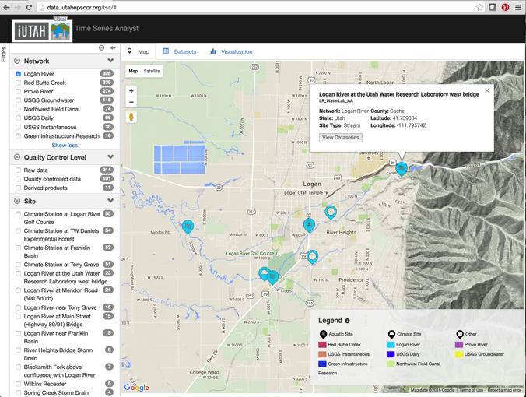
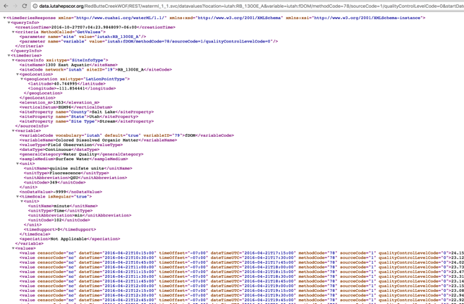
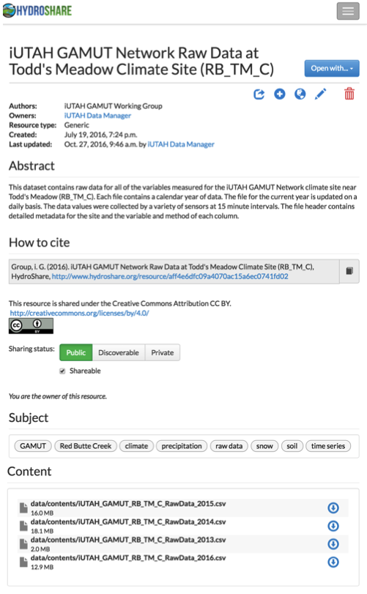
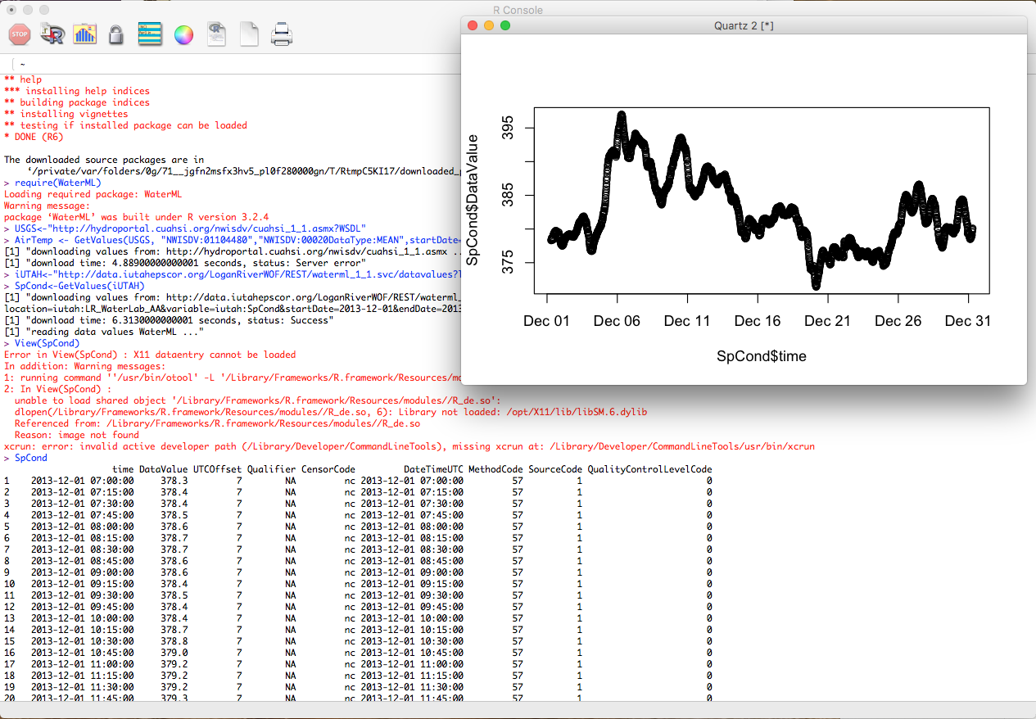
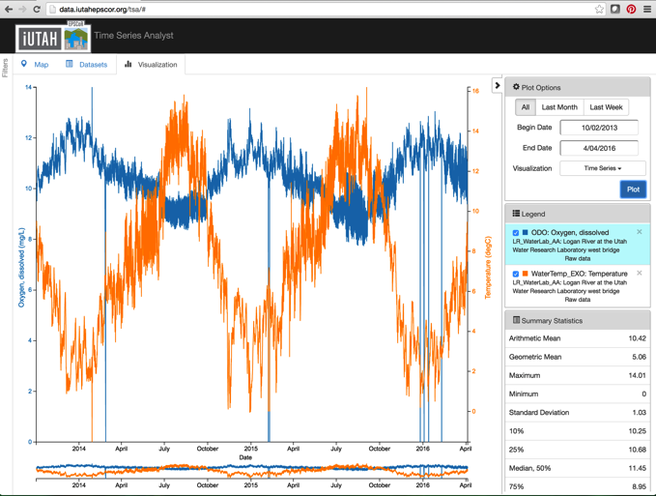
GAMUT: Accessing Sensor Data
HydroShare: Data available in flat files (csv) and updated daily
Time Series Analyst: Web interface, map and plot tools, and data export
Web Services: Programmatic data access
Notes:
GAMUT data are available via several mechanisms.
HydroShare is a data repository where we are publishing data in flat files.
The time series analyst web interface provides map based data discovery, data export,and plotting tools.
The GAMUT data are also published via web services, and registered with the CUAHSI Water Data Center, which makes them available in a national context alongside other data. Web services gives programmatic access and can be called from Python or R or choose your favorite programming interface.

Slide 21
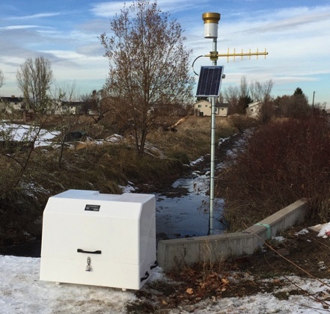
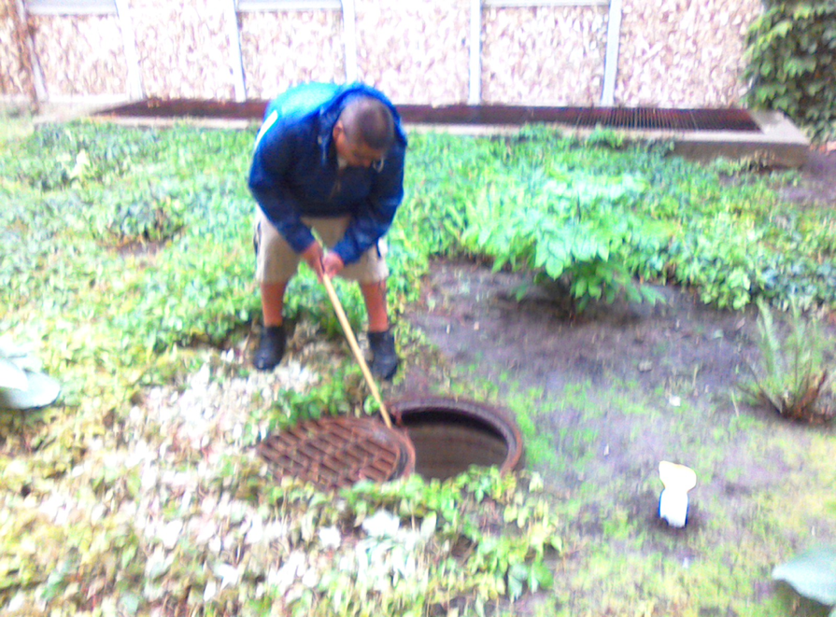
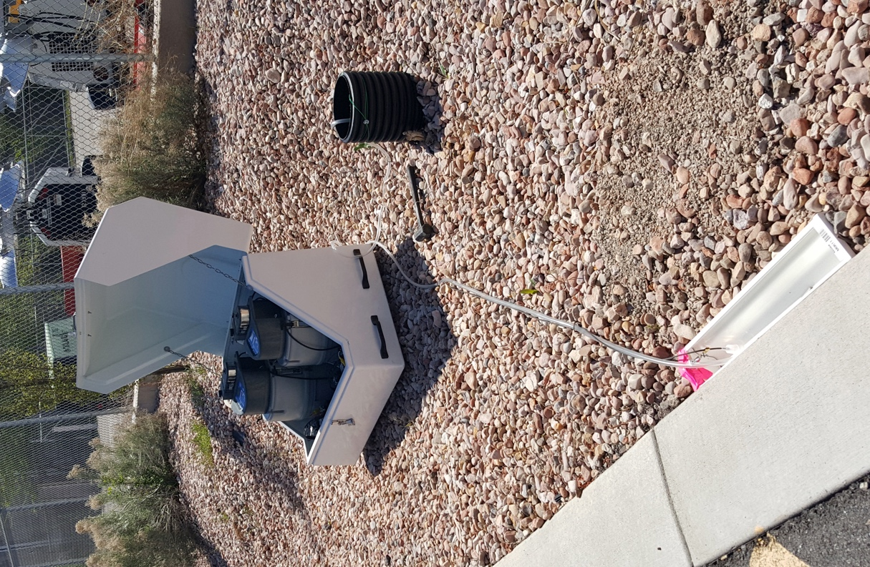
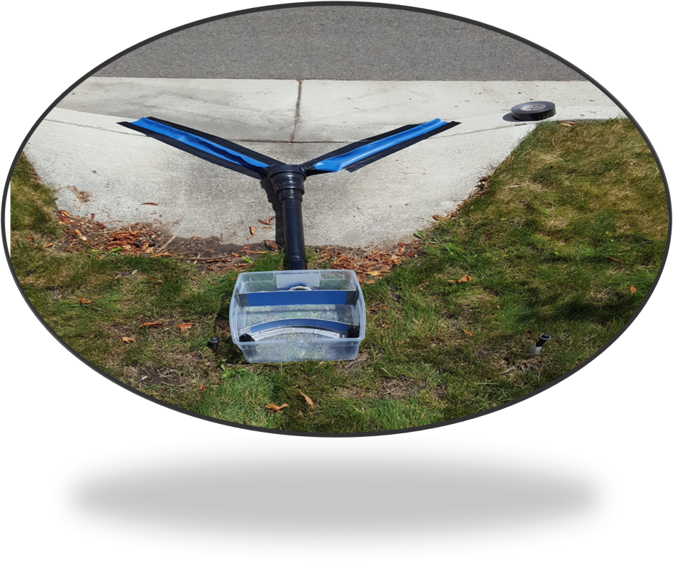
GAMUT Extensions: Additional WQ Efforts
Stormwater/canal network
Residential stormwater and stormwater harvesting
Notes:
So, I’ve covered the core water quality data being collected and compiled by iUTAH. There are also a number of dispersed efforts being conducted where researchers are piggybacking on GAMUT infrastructure to expand research questions.
Stormwater/canal: Jeff Horsburgh’s research team has instrumented a combined stormwater/canal system in Logan similar to GAMUT aquatic sites. We’ve also collected water quality samples here and are working on the development of surrogate relationships for TSS/phosphorus as well as analysis of organic matter.
Residential stormwater: Ryan Dupont and others have instrumented a green infrastructure system where they are studying plant uptake and pollutant removal. Using GAMUT infrastructure.

Slide 22
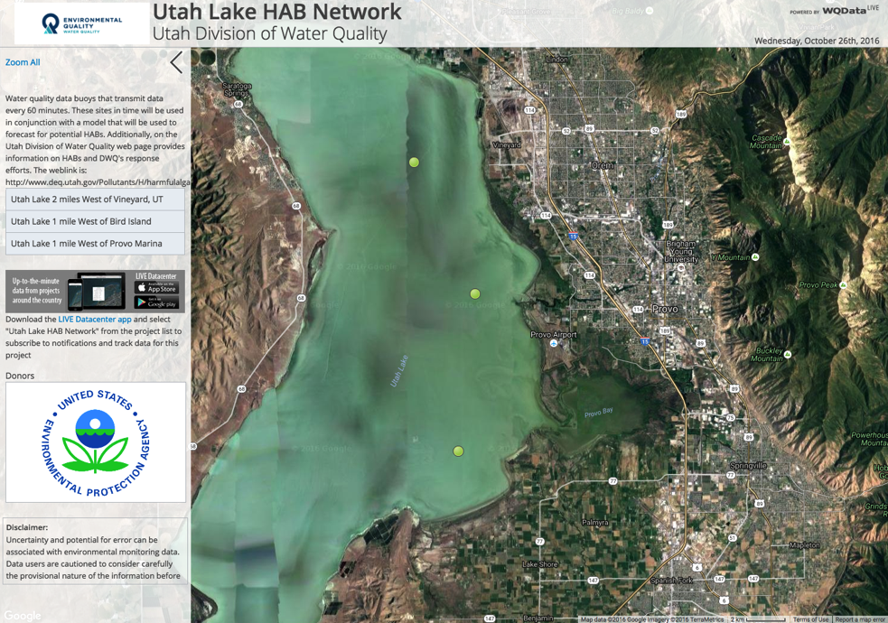
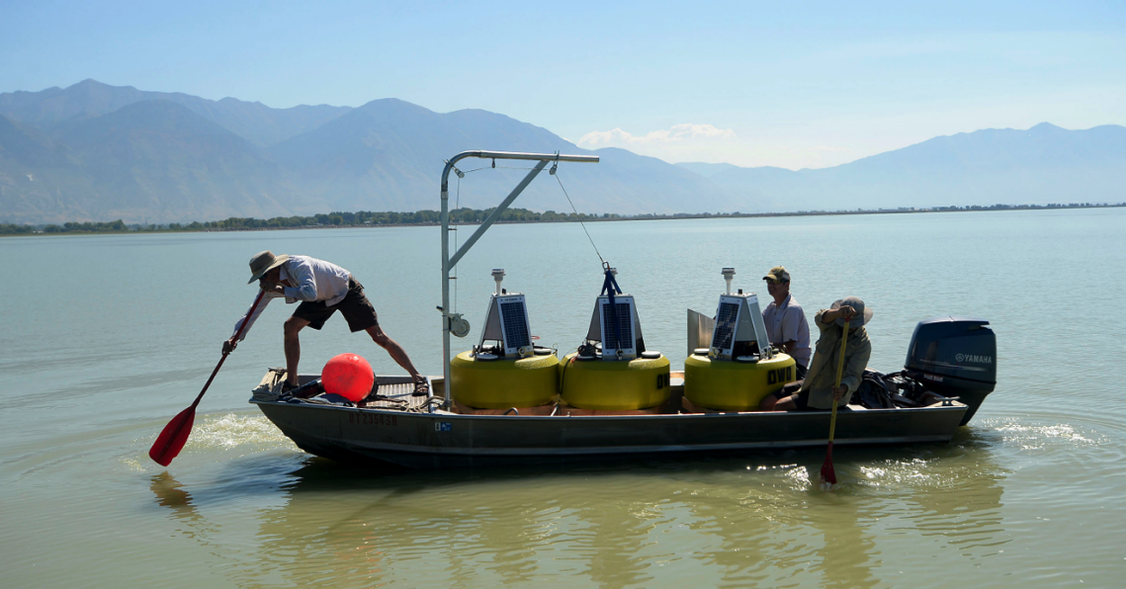
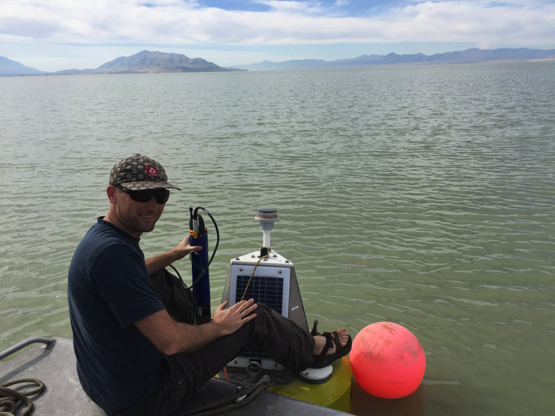
GAMUT Extension: Utah Lake Buoys
GAMUT staff working with State DEQ
Assisted with installation and maintenance
Streaming buoy data
Proprietary Data System
USU FTP Server
CSV
Files
CSV
Files
CSV
Files
CSV
Files
CSV
Files
CSV
Files
Script
Operational Database
Streaming Data Loader
Photo: Al Hartman, Salt Lake Tribune
Notes:
Did you know:
GAMUT staff have worked with the state DEQ to deploy buoys with water quality monitoring sensors to Utah Lake, and we are working to stream the resulting data alongside other GAMUT data

Slide 23
Core Questions
How can we train a next generation of more cyber-savvy engineers, scientists, and professionals who are capable of working in data-intensive research and professional environments?

Slide 24
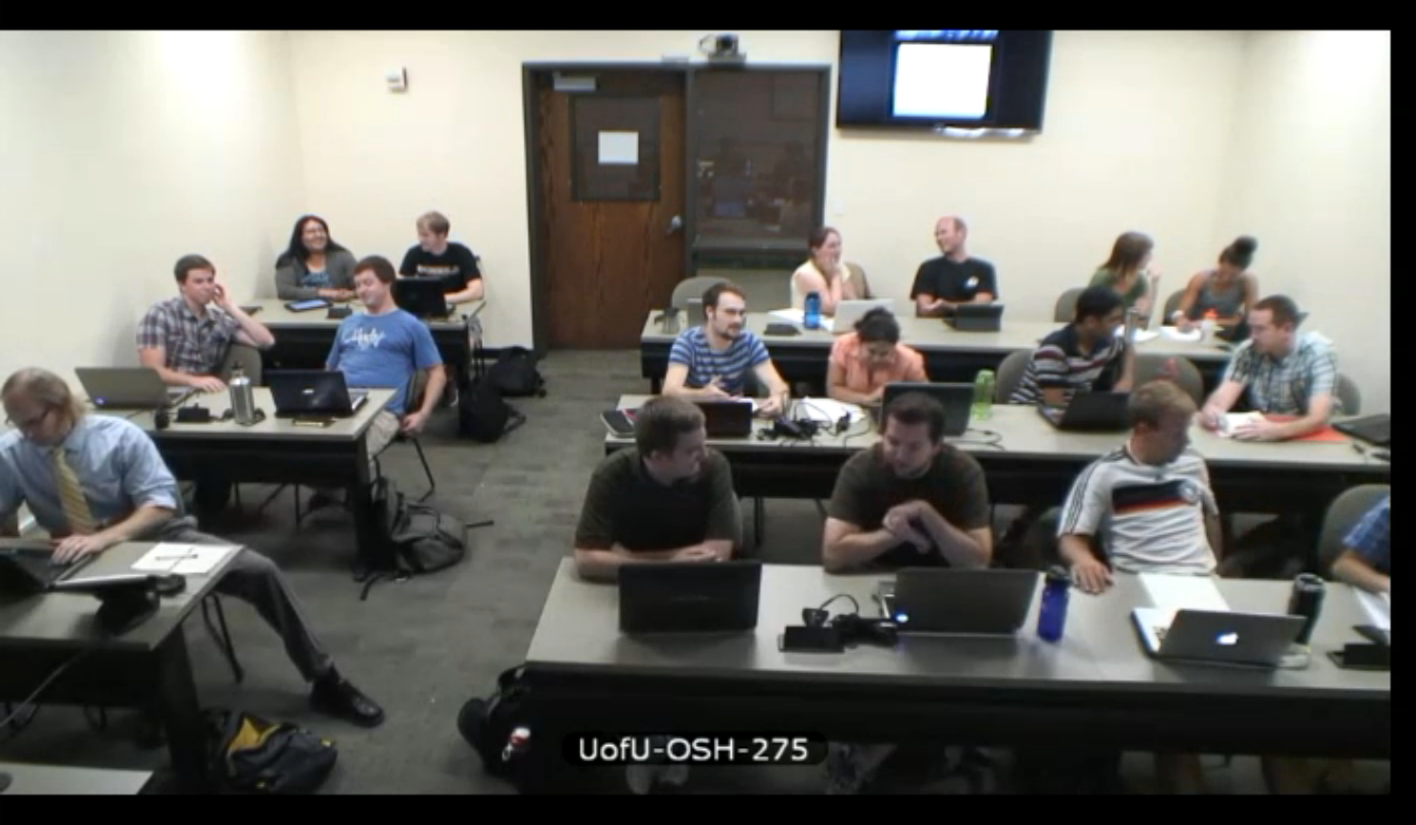
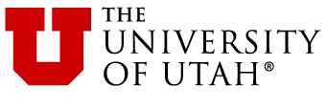
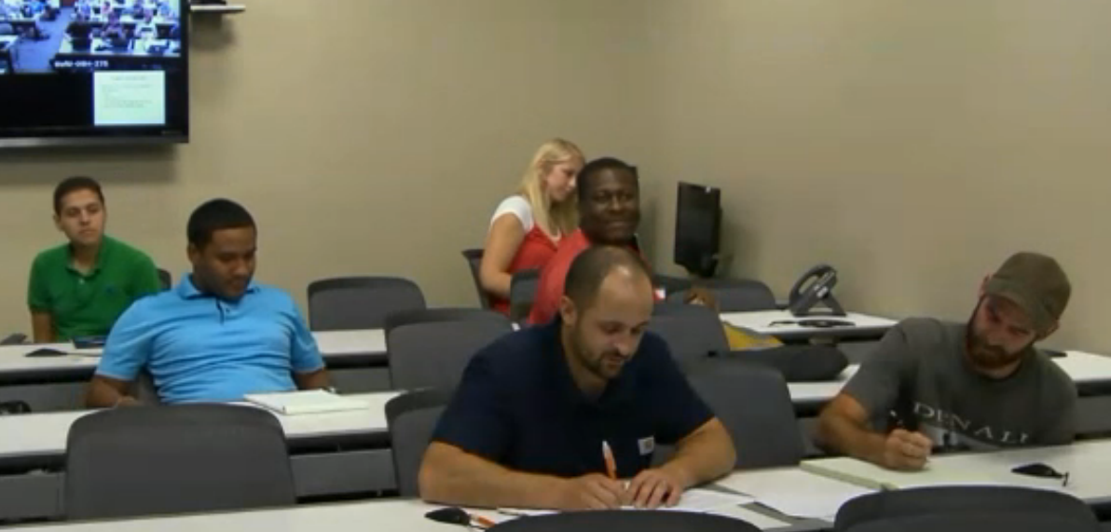


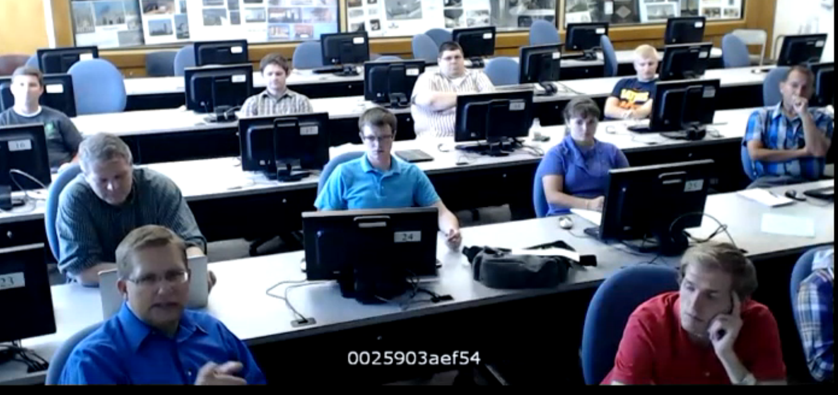
Hydroinformatics Course
3 to 5 partner universities
30 - 45 students total across the campuses
We focus on:
Data and the data life cycle
Databases and data models
Data visualization, transformation, analysis, and modeling
Technologies we use:
Relational database management systems
Structured query language
Python Programming
R Statistical Computing
“My team used basic concepts from almost every class period and topic section in our term project. It was cool to see how all the individual skills added up to help us create and maintain hydrologic information.”

Slide 25
What’s next?

Slide 26
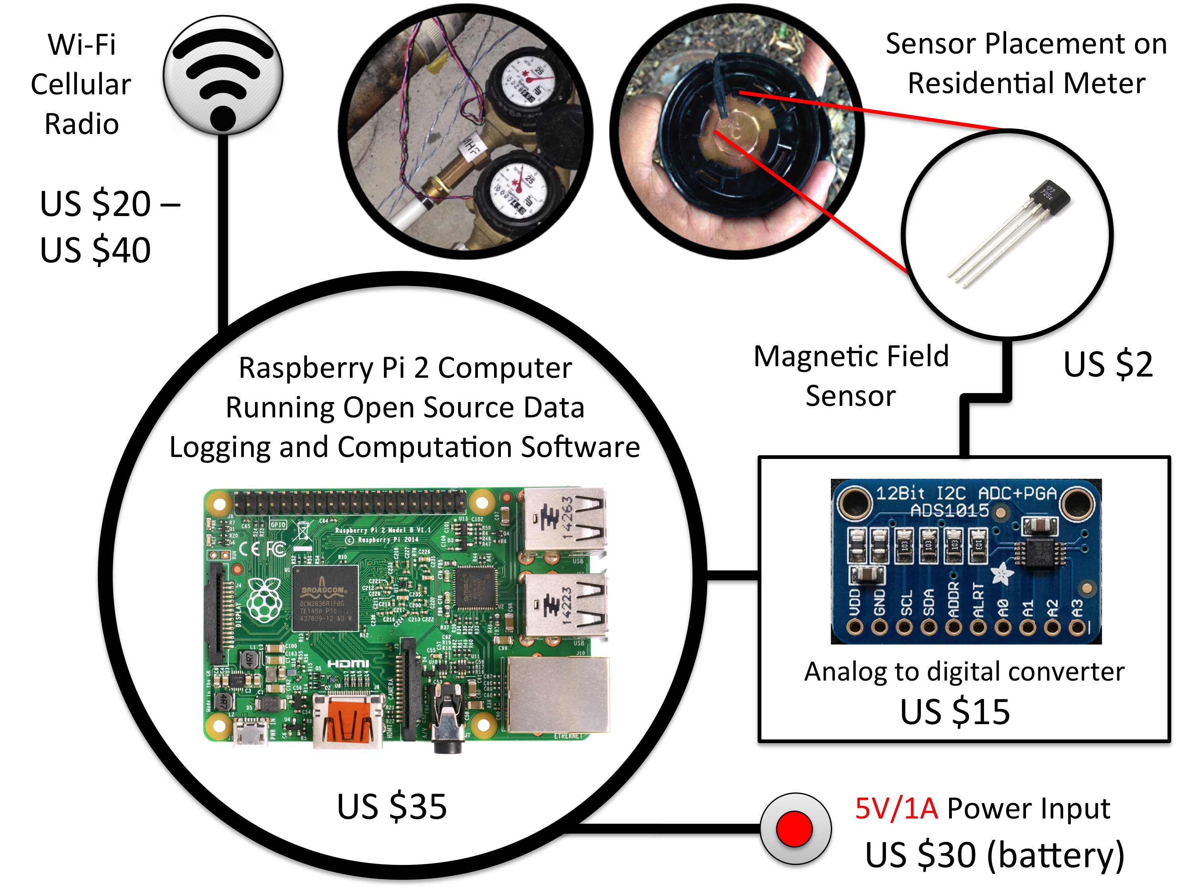
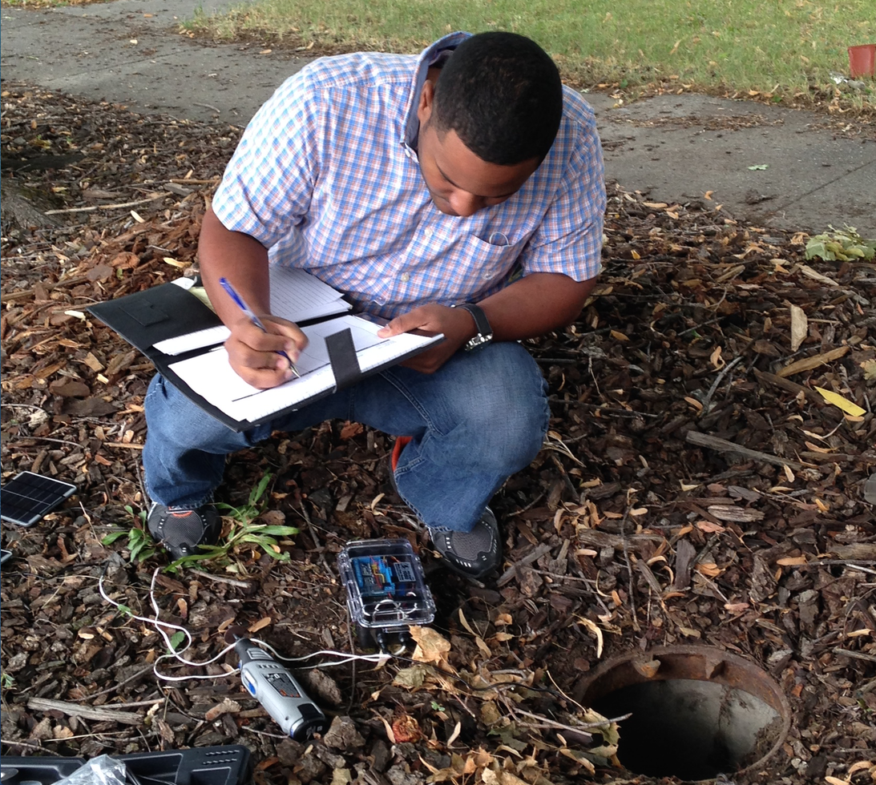
Smart Metering and Residential Water Use Studies
How can detailed information about the timing of water demand be used by water providers to ensure water availability and efficiency now and in the future, plan for related energy demand, and increase customer satisfaction?

Slide 27
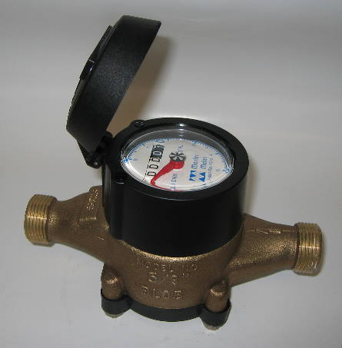
Making Existing Meters Smarter
+
Hypothesis: Computation and disaggregation of individual water use events at the data collection site can effectively “shrink” the Big Data produced by smart meters, overcoming storage and communication bandwidth limitations and providing more timely, decision-relevant information.
Notes:
Most residential water meters are still analog and don’t have the capability to generate the type of high frequency data we need to characterize water end uses. They also have no data storage capability and only very limited data transmission capability.
For about $100, we can add a “piggy-back” device that enables us to capture and store high frequency data, without requiring replacement of the meter or affecting it’s function. These devices include a fully functioning Linux computer and associated sensors and communication peripherals.
Our goal is to turn each meter into a computational node capable of collecting high frequency data, disaggregating data into individual end uses, and then storing and transporting only important summary information.

Slide 28
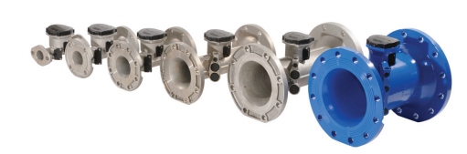
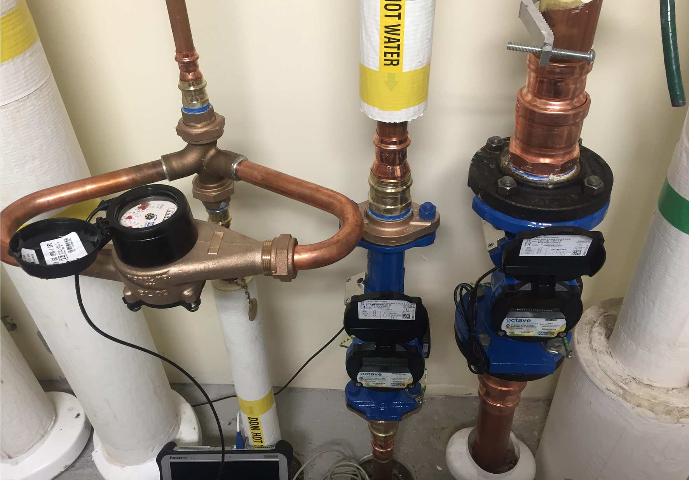
Residential and Non-Residential Contexts
Most monitoring, modeling, and conservation research has focused on residential users
Extending to businesses, commercial establishments, and institutions
Resolving total water use and component end uses
Identifying opportunities for conserving both water and associated energy (pumping, heating, etc.)
Notes:
Our work is expanding current water metering methods, enhancing available monitoring data, and providing the basis for estimating important operational variables such as peak demand and timing of demand for both residential and commercial/industrial users.
The data we are collecting are also instrumental in identifying opportunities for water conservation and for quantifying the effects of conservation activities

Slide 29
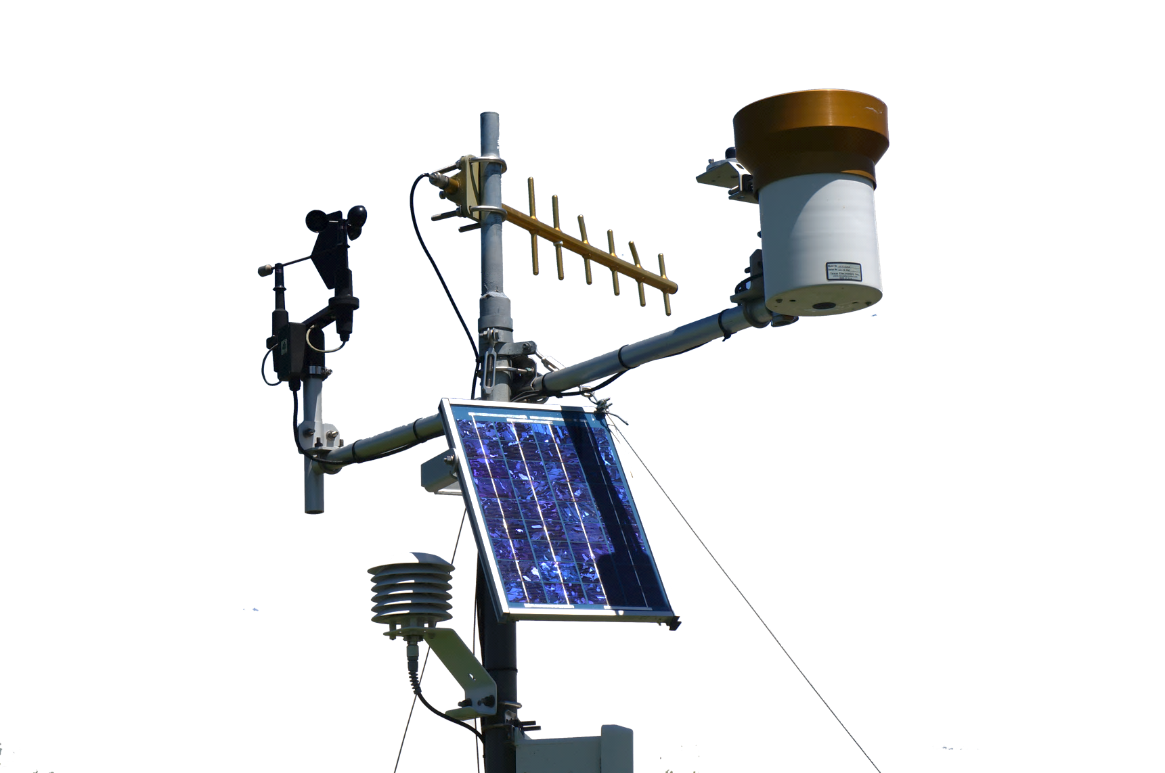
Questions?
Our software and code is open source.
Jeff Horsburgh
jeff.horsburgh@usu.edu
http://www.iutahepscor.org
http://data.iutahepscor.org

